Slide 1
ENTER

Slide 2
Starting
briefing

Slide 3
Confirming identity
Starting retinal scan
Identity checked

Slide 4
Welkom special agent SGWD7

Slide 5
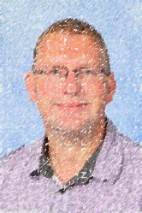
The mission
Goodmorning special agents of SGWD
Your mission for the next year is:
Make an impression on this man:

Slide 6
She Will inform you of the newest technology and gadgets available for your mission
This agents is your contact in the field: SGWD.KWN7

Slide 7
Kahoot
The gadgets that are beschikbaar are the following:
prezi
edpuzzle
glogster
educaplay
Quayn
learningapps
Google drive
blubbr
padlet
Be sure to pick your favourite tooltje after this briefing

Slide 8
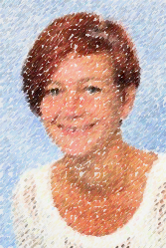
For back up about this gadgets, contact this woman
Extra support

Slide 9
This message will not self-destruct due to our bezuinigingen

Slide 10
Good luck agents!
The world (and Ivo) are counting on you!

